Slide 1

Microsoft Purview
Unified Data Governance to Maximize the Business Value of Data

Slide 2
Data-driven transformations yield significant benefits
54%
44%
increase in
revenue performance
faster time to market
62%
54%
improvement in
customer satisfaction
increased profit results
Source: How to lead a data-driven digital transformation by Harvard Business Reveiw
Notes:
The benefits of getting this right are significant. Harvard’s Business Review found that organizations that embrace data to drive transformations experience:
A 54% growth in revenue and profits
62% enhancement to customer satisfaction and 44% faster time to market
Relative to their peers. The stakes are high and an organization’s growth prospects ultimately depend on data at its core.

Slide 3
Today’s data realities
3
What data do I have?
Data governance
Is it trustworthy?
2
Can people access the data needed to make the right decisions?
Analytics
1
How can I enable faster business insights?
Operational Databases
Operational databases
What’s my compliance exposure?
Notes:
…And doing this isn’t easy, given the realities of data today. The volume, variety and velocity of data are all accelerating dramatically, and the complexity of creating of an enterprise ‘knowledge graph’ can seem insurmountable. Today we generate data far faster than we are able to understand it
In fact, IDC predicts that by 2025, just 5 years from now, the world’s data will climb to 175 zettabytes. To put that in perspective, if you were to store that data in a stack of BluRay discs you’d be able to go to the moon and back 23 times!
Without the right people, processes and capabilities in place, it can be difficult to answer fundamental questions like:
What data do I have?
Is it trustworthy?
Are people getting the data they need to make the right decisions?
Are they getting it fast enough?
And are we managing data in a compliant way?...

Slide 4
Introducing Microsoft Intelligent Data Platform
2
Transform with the Microsoft Cloud
Microsoft Cloud
Dynamics 365 • Microsoft 365 Power Platform
3
Data governance
2
Analytics
1
Operational databases
2
Microsoft Intelligent Data Platform
SQL Server • Azure SQL • Azure Cosmos DB • Azure Synapse Analytics
Power BI • Microsoft Purview • Azure AI
Notes:
Getting the right answers to these questions is possible when all your data assets are connected and managed in a cohesive fashion. This is why we announced the Microsoft Intelligent Data Platform, the leading cloud data platform that empowers organizations to invest more time creating value rather than integrating and managing their data estate.
The platform is made up of capabilities across databases, analytics and governance that, on their own, meet specific business needs and already bring many benefits but together helps easily evolve applications to include advanced analytics and intelligence. It is the integration of the products you are already using today to accelerate innovation and achieve agility, across our cloud, as well as others
We want to remove key points of friction between your databases and analytics systems while ensuring your full data estate can be automatically mapped and governed
Organizations can analyze large volumes of operational data in near real-time with no extraction, transformation, or loading (ETL) pipelines, and no performance impact on transactional workloads
And anyone in the organization, whether they’re a data scientist, data analyst or a domain expert, can access, analyze, and share data
This is the state we are all aiming for is where we can:
Accelerate innovation, Focus on what matters most – your business. Free resources to create frictionless customer experiences, transform products and empower employees.
Achieve agility, Pivot faster to respond to dynamic environments with an integrated data platform that adapts to your needs with hybrid and multi cloud capabilities. Build how you want, deploy where you want and gain fast, continuous insights.
Build on a trusted platform, Deliver data-powered experiences with the security and privacy controls required to innovate with confidence. Azure provides the most comprehensive protection for your valuable business data.

Slide 5

Transform with the Microsoft Cloud
Transform with the Microsoft Cloud
Introducing Microsoft Intelligent Data Platform
2
Microsoft Cloud
Dynamics 365 • Microsoft 365 Power Platform
1
2
1
2
3
Microsoft Intelligent Data Platform
SQL Server • Azure SQL • Azure Cosmos DB • Azure Synapse Analytics
Power BI • Microsoft Purview • Azure AI
Operational databases
Analytics
Data governance
Operational databases
Analytics
Data governance
Operational databases | Analytics | Data governance
Notes:
We're also integrating The Intelligent Data Platform with the rest of the Microsoft Cloud, for enabling richer data experiences for business users of Microsoft 365 and Dynamics 365 and Power Platform.

Slide 6

Data is your most strategic asset
90%
175 ZB
Of corporate strategies will cite information as a critical enterprise asset by 2022
Expected global volume of data generated annually by 2025
GARTNER
IDC
Why Data and Analytics are key to digital transformation. Christy Pettey. Mar, 2019
IDC Data Age 2025, Dave Reinsel,

Slide 7



Data governance is becoming increasingly interdisciplinary
DISCOVERY
COMPLIANCE
What data do I have?
Where did the data originate?
Can I trust it?
What’s my exposure to risk?
Is my usage compliant?
How do I control access & use?
What is required by regulation X?
Chief Data Officer

Slide 8
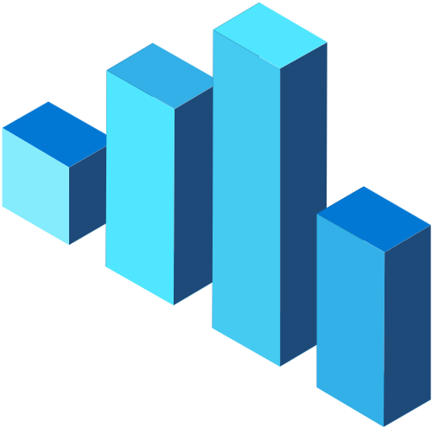

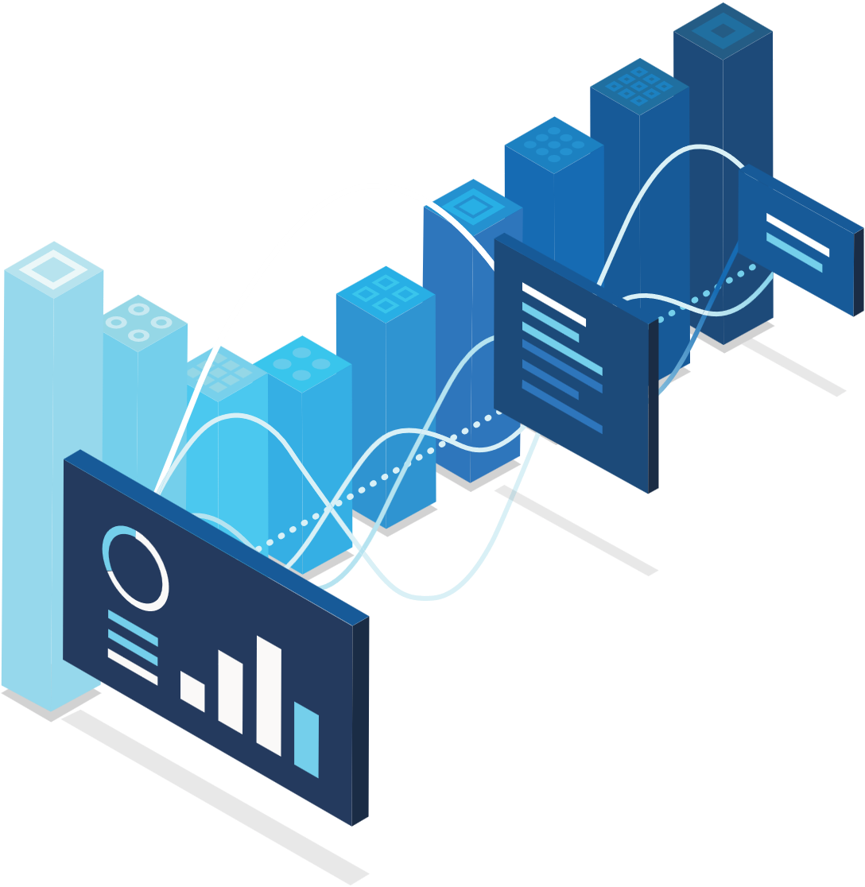






Elements of successful data governance
Manage growing data landscape
Overcome operational silos
Increase data agility
Comply with industry regulations

Slide 9
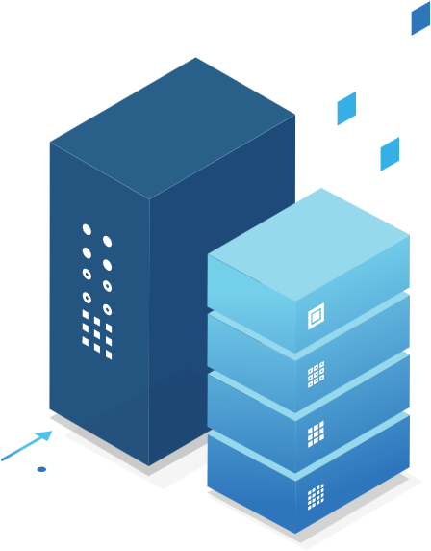







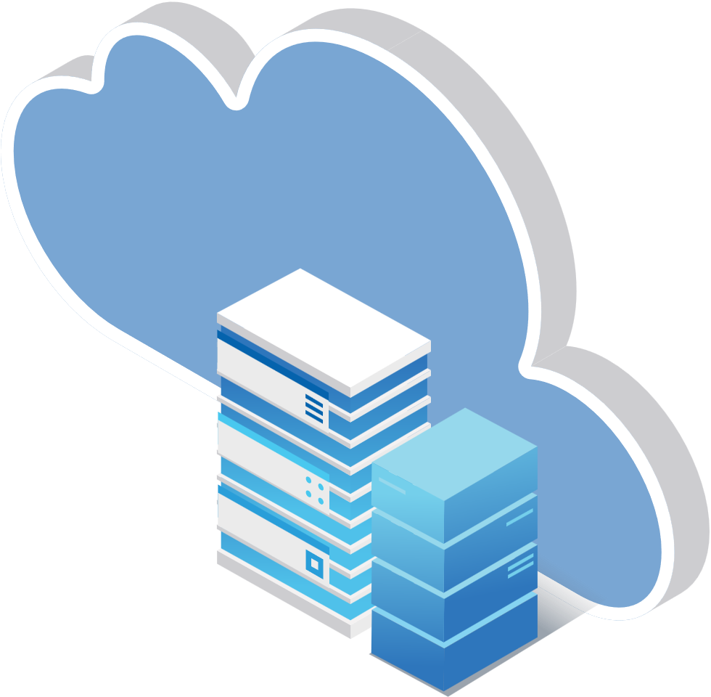
Reimagine
data governance with Microsoft Purview
On-prem
Unified | Hybrid | Open
SaaS
Multicloud

Slide 10
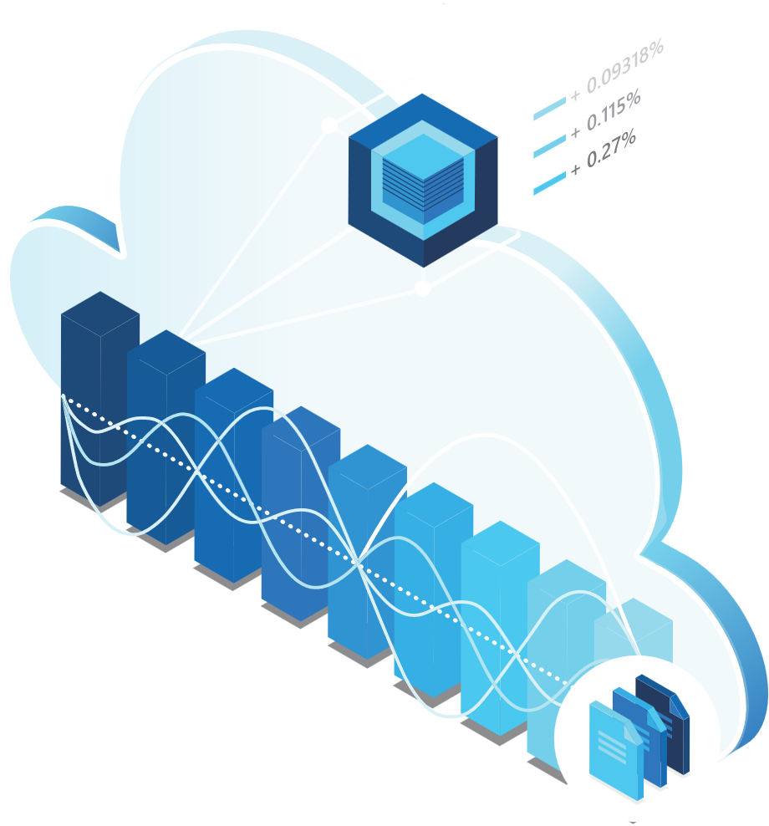

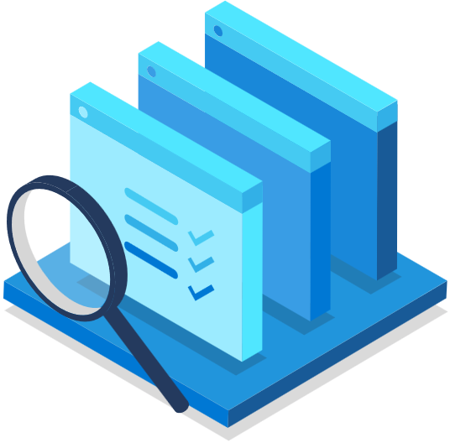

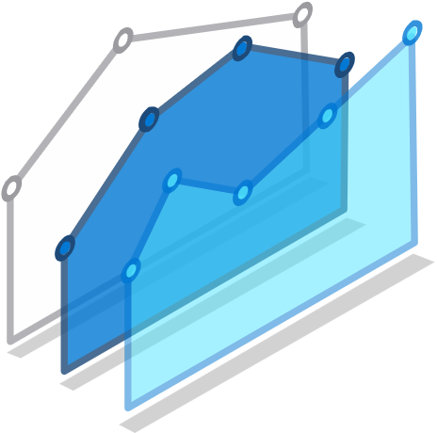





Microsoft Purview enables unified data governance
Reimagine data governance in the cloud
Set the foundation for effective data governance
Maximize business value of data for data consumers
Gain strategic insight into data use across the estate

Slide 11

Reimagine data governance in the cloud
Manage and govern operational, transactional and analytical data
Cloud-native, purpose-built service to address discovery and compliance needs
Fully managed, serverless, PaaS service
Eliminate manual, ad-hoc and homegrown solutions

Slide 12

Establish the foundation for effective data governance
Automate discovery of data in on-premises, multi-cloud and SaaS sources
Classify data at scale to specify sensitivity, compliance, industry, business and company-specific value
Know where data came from and what was derived from it with data lineage

Slide 13

Maximize business value of data
Connect business and technical data analysts, data scientists, and data engineers to a trusted data catalog
Enable users to quickly find data and view its lineage and sensitivity
Deliver a curated and consistent glossary of business terms and definitions

Slide 14

Gain insight into data use across the estate
Understand at a glance how data is being created and used across your data estate
Visually assess the state of data assets, scans, business glossary and sensitive data

Slide 15









Unified Data Governance with Microsoft Purview
Generally Available
Preview
Azure
Synapse
Analytics
Microsoft Purview
On-prem
Data Producers and Consumers
Data Officers
SQL Server
Data Catalog
Enable effortless data discovery
Data Sharing
Share data within and between organizations
Data Estate Insights
Assess data estate health
Data Policy
Govern access to data
Power BI
Cloud
Data Map
Automate and manage metadata at scale
Azure SQL
SaaS
Applications

Slide 16

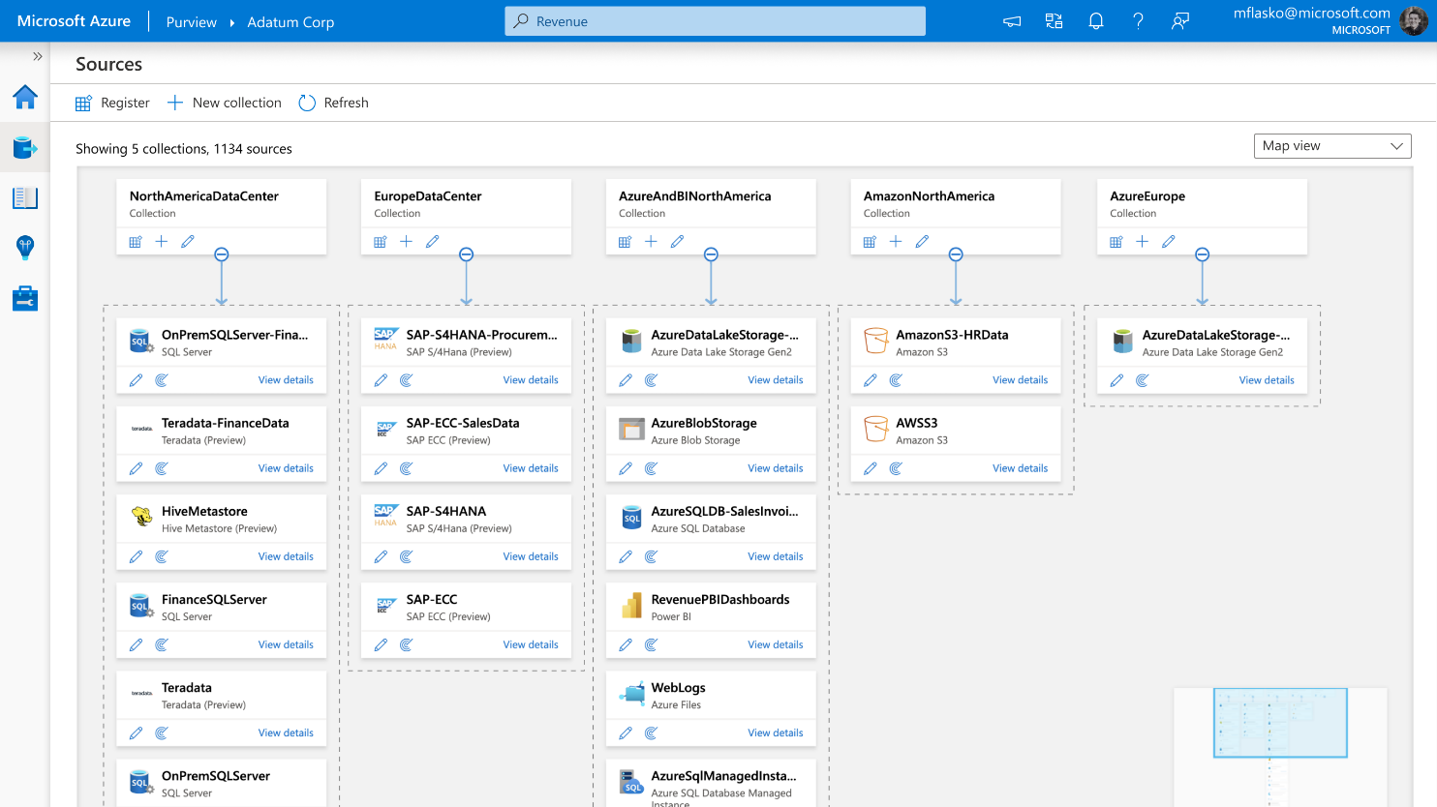
Unify and make data meaningful using Microsoft Purview Data Map
A graph describing the data assets and their relationships across your data estate
Automated data scanning, classification and lineage extraction of hybrid data stores
200+ built-in data classifiers
Support for 35 data sources and growing

Slide 17

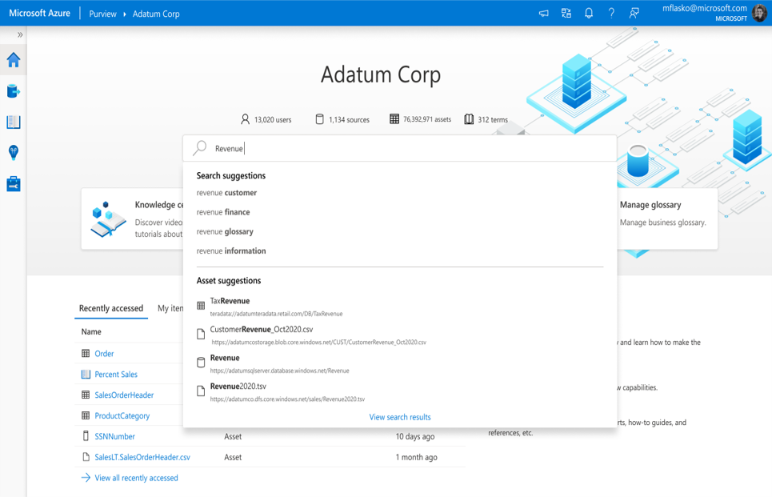
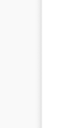
Enable effortless discovery of trusted data with Microsoft Purview Data Catalog
Search, browse & curate
Intelligent recommendations
Lineage visualization

Slide 18
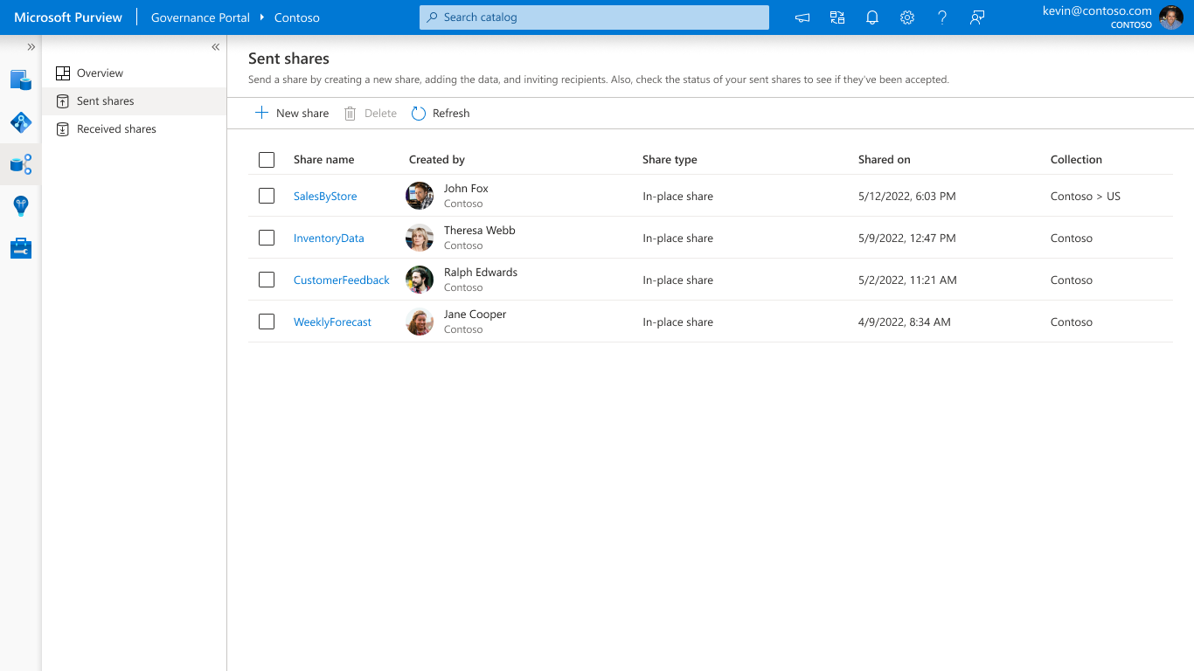
Share data within or between organizations using Microsoft Purview Data Sharing
Easily share data in-place with no data duplication
Near real time access to shared data
Centrally manage sharing relationships
Supports Azure Data Lake Storage (ADLS Gen2) and Blob Storage

Slide 19
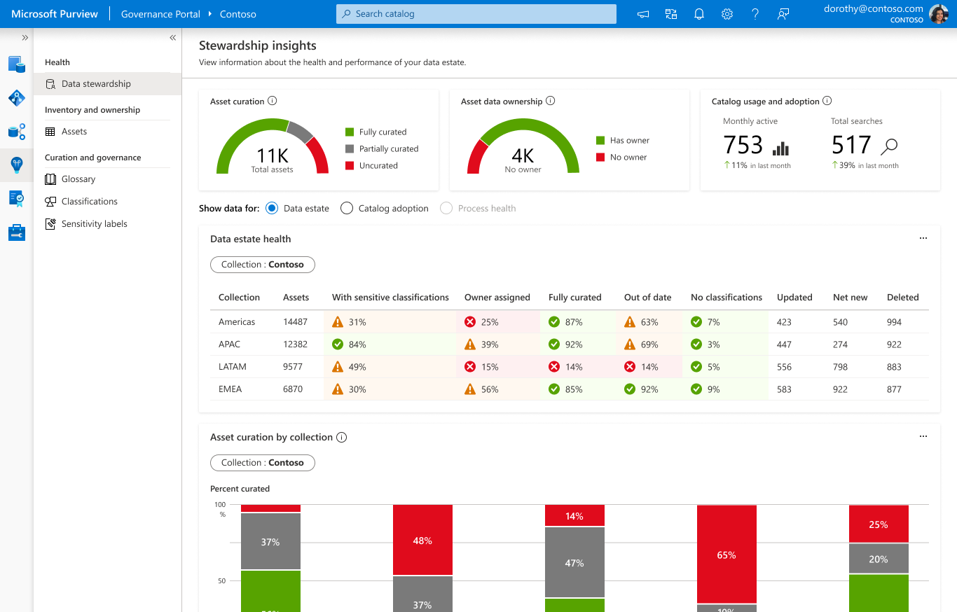
Get a bird’s-eye view of your data landscape with Microsoft Purview Data Estate Insights
Data Stewardship
Data Asset distribution
Sensitive Data
Business Glossary Utilization

Slide 20
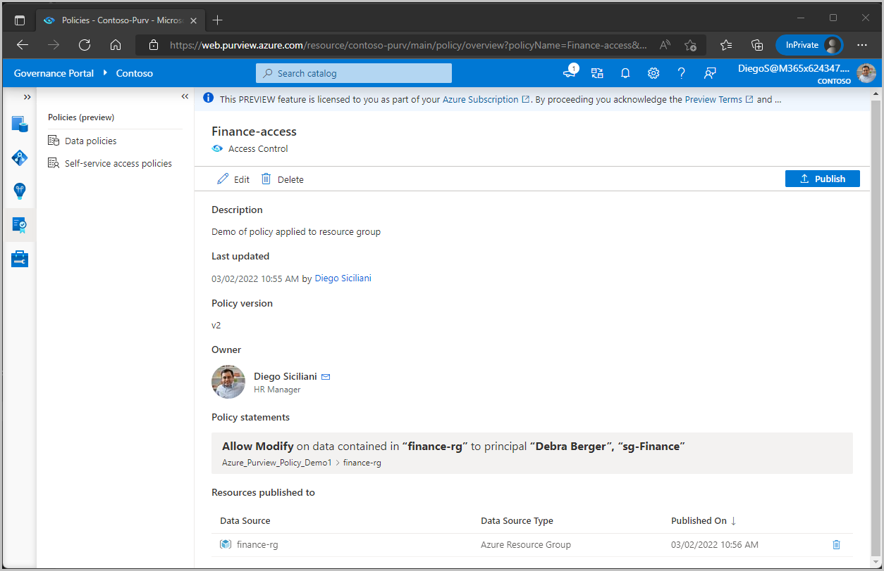
Provision access to data through an intuitive authoring experience with Microsoft Purview Data Policy
Enable data engineers and owners to provision access to data assets
Supports subscriptions, resource groups, Azure Blob Storage, Azure Data Lake (Gen2), Azure SQL DB, and SQL Server 2022

Slide 21








Make the most of your Microsoft investments
Multi-cloud,
Hybrid, and SaaS
Operational and Analytical data

Slide 22
Microsoft Purview
Features
Microsoft Purview Data Map | Generally Available | In Preview
Automated scanning of hybrid sources
Multi Cloud Scanning for AWS S3
Data Classification
Apache Atlas API support
Microsoft Purview Data Catalog
Search and Browse
Business Glossary
Data Lineage
Microsoft Purview Data Estate Insights
Data Stewardship report
Assets report
Glossary report
Classification and Labelling Reports
Asset-level drill down by sensitivity Trends, drill downs and ability to take action
Export asset list into CSV file for offline tracking with data owners
Microsoft Purview Data Policy
Author and enforce data access policies for subscriptions, resource groups, Azure Blob Storage, Azure Data Lake (Gen2) and SQL DevOps roles
Microsoft Purview Data Sharing
In-place sharing for Azure Blob Storage and Azure Data Lake (Gen2)

Slide 23


“Purview not only addresses the governance needs of our ambitious data estate, but the latest discovery features and simple UI will empower our analyst community to search and quickly understand the data across Heathrow. The ability to easily discover assets and browse lineage will ensure we follow trusted data across the enterprise based on common data standards, driving us to be more data-driven and efficient.“
Microsoft Purview Customer Spotlight
ANDREW ISENMAN | Head of Technology: Cloud and Data

Slide 24
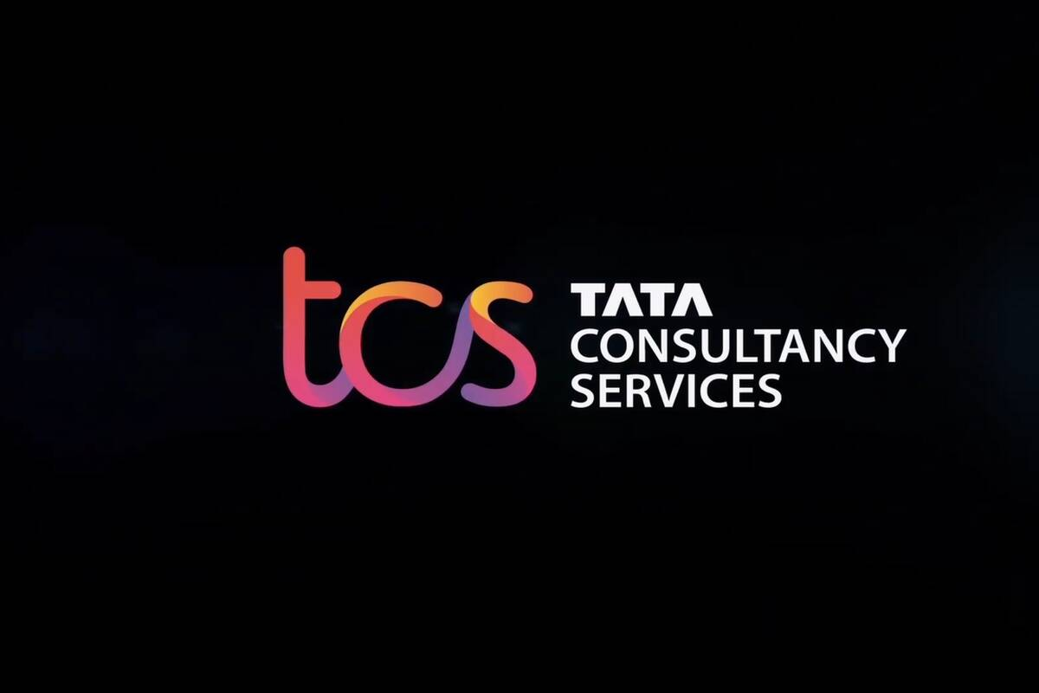












Microsoft Purview Trusted Partners

Slide 25

© 2020 Microsoft Corporation. All rights reserved. Microsoft, Windows, Windows Vista and other product names are or may be registered trademarks and/or trademarks in the U.S. and/or other countries.
The information herein is for informational purposes only and represents the current view of Microsoft Corporation as of the date of this presentation. Because Microsoft must respond to changing market conditions, it should not be interpreted to be a commitment on the part of Microsoft, and Microsoft cannot guarantee the accuracy of any information provided after the date of this presentation. MICROSOFT MAKES NO WARRANTIES, EXPRESS, IMPLIED OR STATUTORY, AS TO THE INFORMATION IN THIS PRESENTATION.

